Slide 1
Samsung Innovation Campus
Artificial Intelligence Course
Notes:
Note:
‹#›

Slide 2
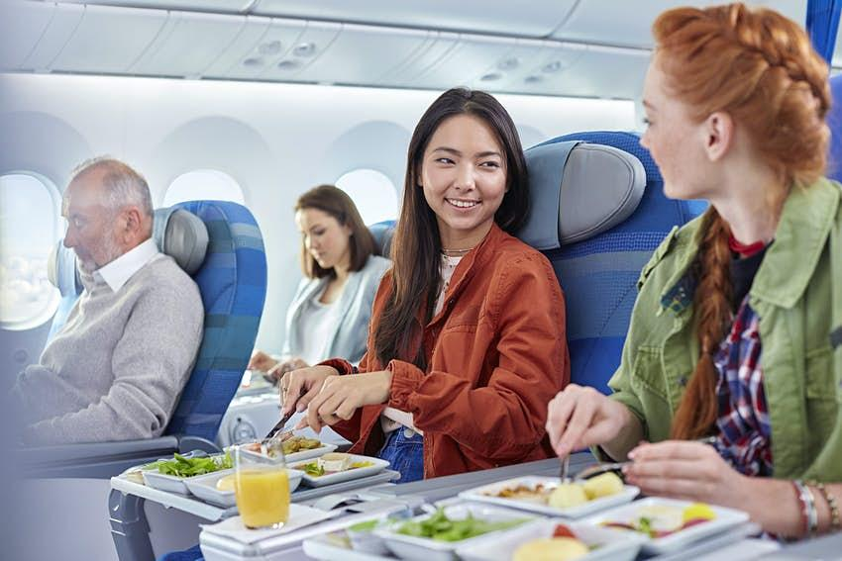
Airline Passenger Satisfaction

Slide 3
Team
Project presented by :
Mina Michael
Mustafa Bakry
Omnia Yasser
Facilitator: Eng. Shimaa
Data Used : https://www.kaggle.com/teejmahal20/airline-passenger-satisfaction
Notes:
Note:
‹#›

Slide 4
Agenda
What is data about?
Our goal
Content
EDA & Preprocessing
Business solution
Modeling
Notes:
Note:
‹#›

Slide 5
What is data about?
This dataset contains an airline passenger satisfaction survey.
It contains some factors that affect the level of satisfaction of the passenger.

Slide 6

Goal

Slide 7

Our Goal
Know the factors affecting customer satisfaction with the service.
Expect customer satisfaction
Giving practical solutions to improve the level of service

Slide 8

Content

Slide 9
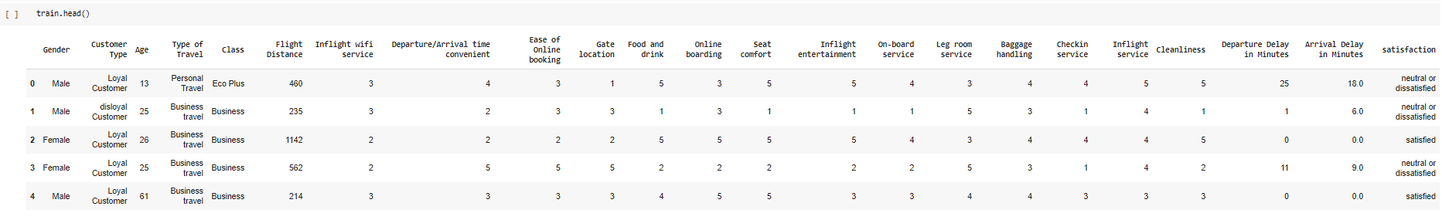
Data head – info – description
Data Frame:
We dropped two columns of “id” , “unnamed;0” they have no effect on the target.

Slide 10
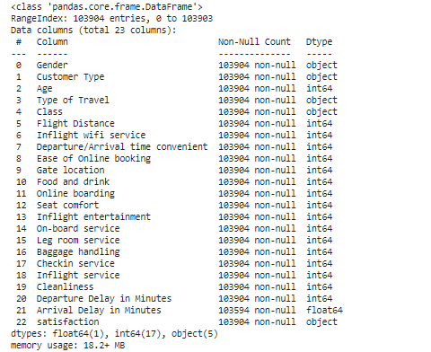
Data head – info – description
Data info:

Slide 11
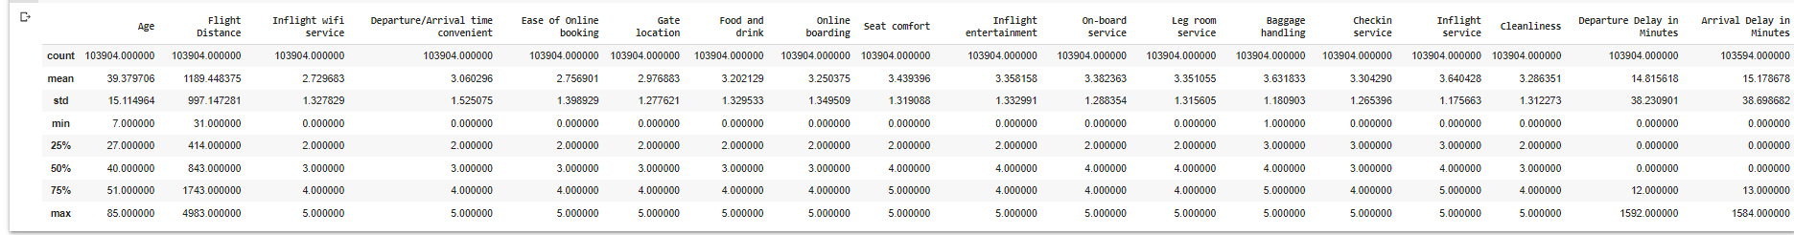
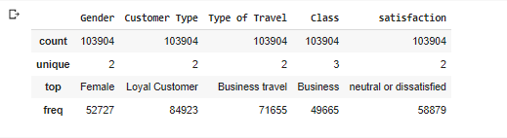
Data head – info – description
Data description:
Numerical features:
Categorical features:

Slide 12

Rating columns
Inflight Wi-Fi service
Departure/Arrival time convenient
Ease of Online booking
Gate location
Food and drink
Online boarding
Seat comfort
Inflight entertainment
On-board service
Leg room service
Baggage handling
Check-in service
Inflight service
Cleanliness

Slide 13
categorical & other features
Categorical features
Other features
Gender
Customer Type
Type of Travel
Class
satisfaction
Age
Flight Distance
Departure Delay in Minutes
Arrival Delay in Minutes

Slide 14
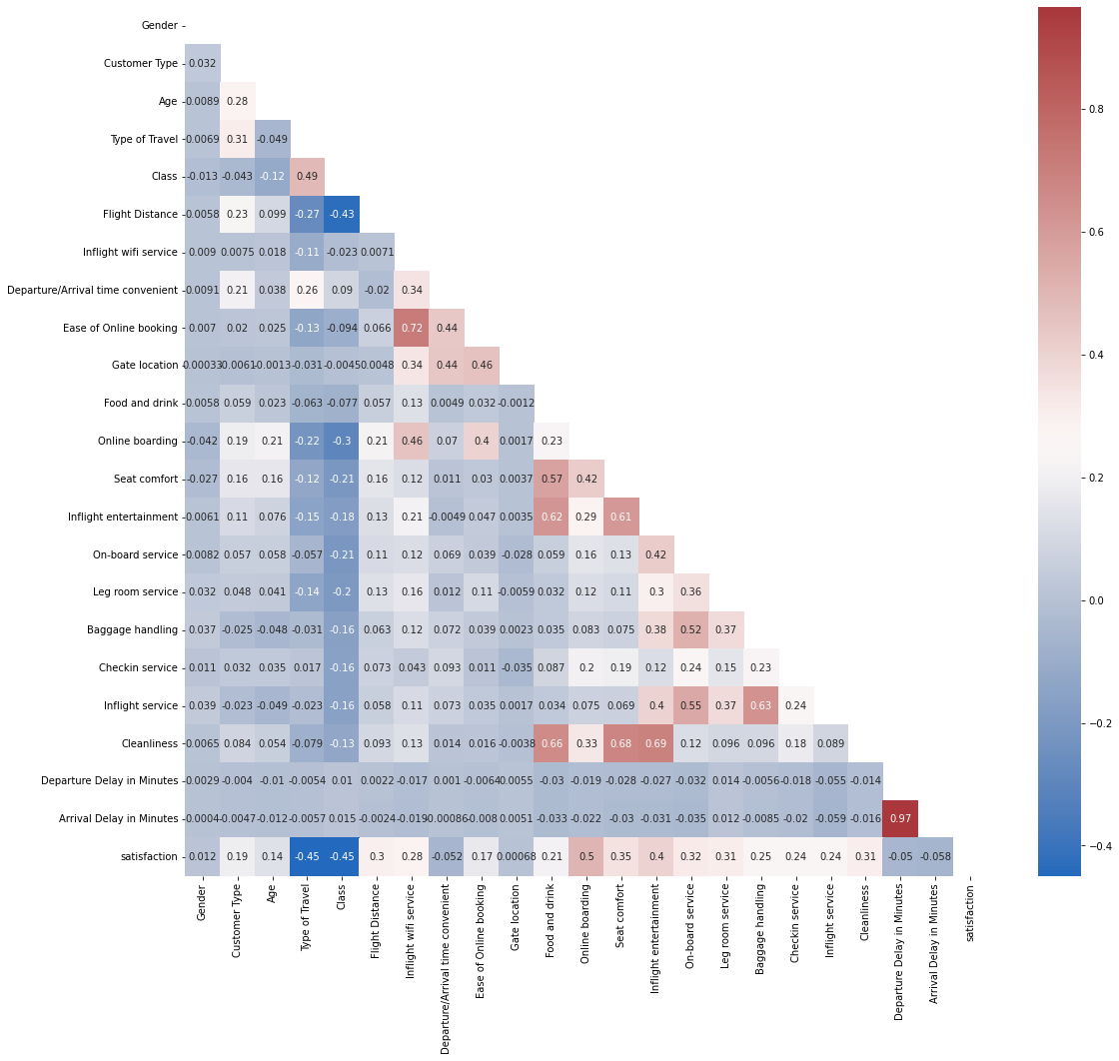
EDA & Preprocessing
Correlation:
As correlation between Departure Delay in Minutes & Arrival Delay in Minutes is so high then we can drop one of them.
We choose to drop Arrival Delay in Minutes as it contains null values.

Slide 15
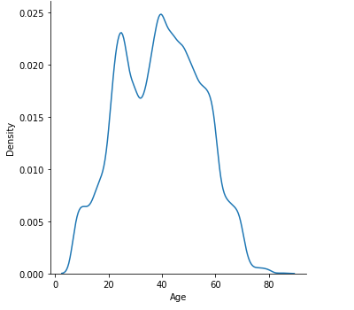
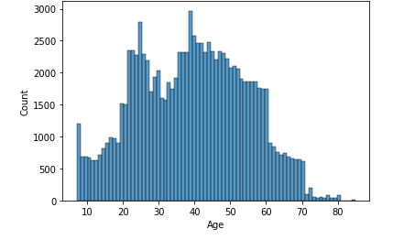
EDA & Preprocessing
Distribution of people age
As we see, most of the passengers their age ranges from 20 to 60 !!

Slide 16
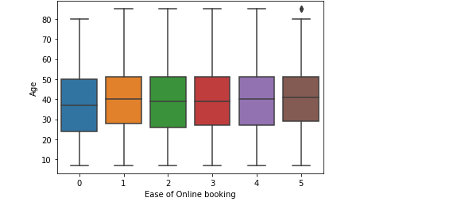
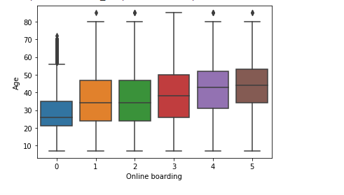
EDA & Preprocessing
Age of people who use online boarding and booking
The average people age who use online boarding and online booking is from 30 to 50 years old
so, why other people don’t use them!!

Slide 17
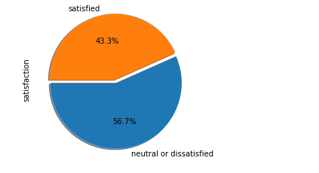
EDA & Preprocessing
satisfied Vs dissatisfied
This pie illustrates the ratio between satisfied and dissatisfied people which shows that they are close to each other
This means our data is balanced, but our target is to increase the ratio of satisfied people

Slide 18
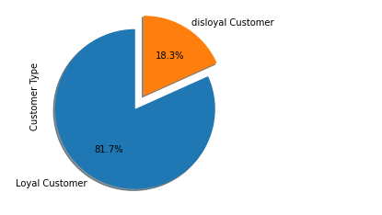
EDA & Preprocessing
Loyal customer Vs Disloyal customer
it’s shown from the figure that most of our customers are loyal to the company
That’s a very good point that we can use it for the marketing of the company.

Slide 19
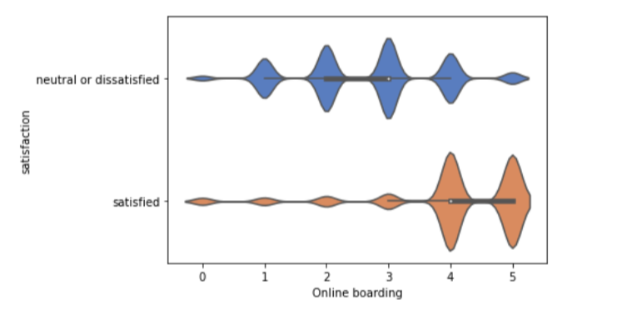
EDA & Preprocessing
Relation between online boarding – satisfaction
This violin plot shows that how online boarding affects the satisfaction of the passenger.
as the online boarding satisfaction increase, the overall satisfaction increases and vice versa

Slide 20
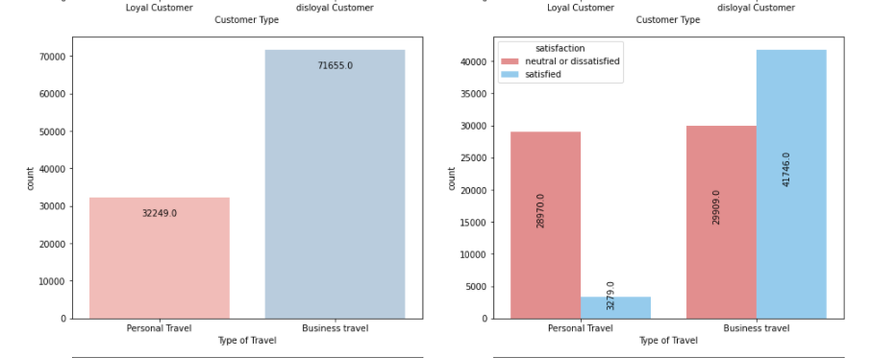
EDA & Preprocessing

Slide 21
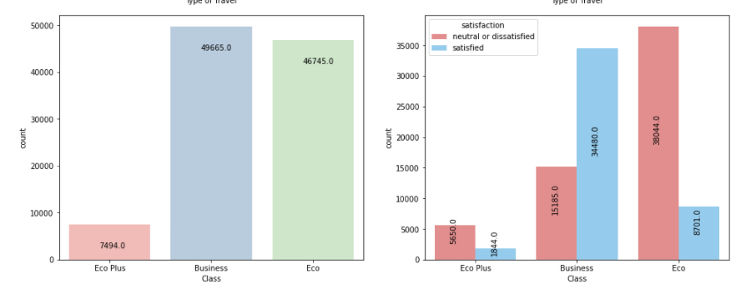
EDA & Preprocessing

Slide 22
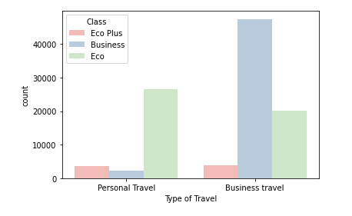
EDA & Preprocessing

Slide 23
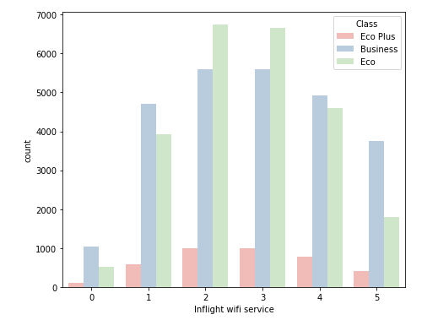
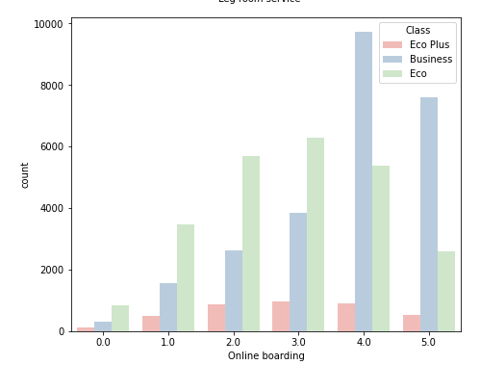
EDA & Preprocessing

Slide 24
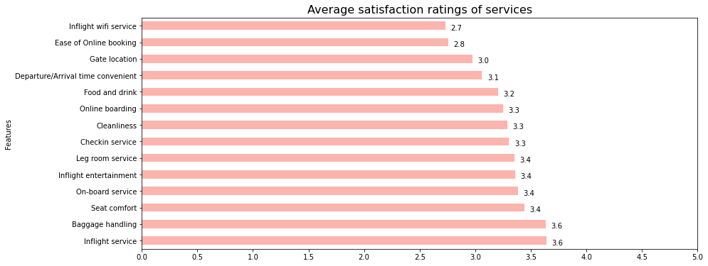
EDA & Preprocessing
This graph shows the extent of customer satisfaction with the services provided

Slide 25
Factors affecting customer satisfaction
Class 🡪 we found a problem in eco class that affects the satisfaction.
Type of travel
nflight WIFI service
Ease of online booking
Food and drink
Online boarding 🡪 (highest effect)
Seat comfort
Inflight entertainment
On – board service
Inflight service
Leg room service
Cleanliness

Slide 26
Business solution
Feature | Solution
Class | Try to improve the service in eco class to increase the satisfaction of this class
Inflight WIFI service | improving the WIFI service as we can
Online boarding | Focusing on online boarding the most ( as it is the highest affecting factor) by developing the website or the mobile application and making it easier for customers to use
Seat comfort | Improving the quality of seats to be more comfortable
Inflight entertainment | provide more ways of Inflight entertainment ( online gaming – music – films )
Food and drink | Variance in food and drinks High quality food and drinks
Cleanliness | Paying attention to the cleanliness of the airport and the plane

Slide 27
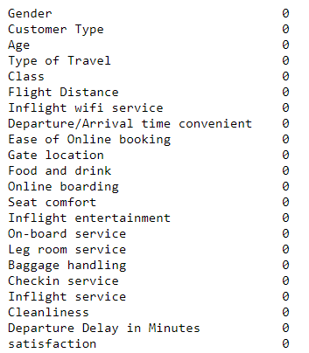
EDA & Preprocessing
Missing values:
As shown above , Num of Null values are small so we can drop them.
missing values was in ”Arrival Delay in Minutes” column .. and we drop this column .
NOW , we have no null values….

Slide 28
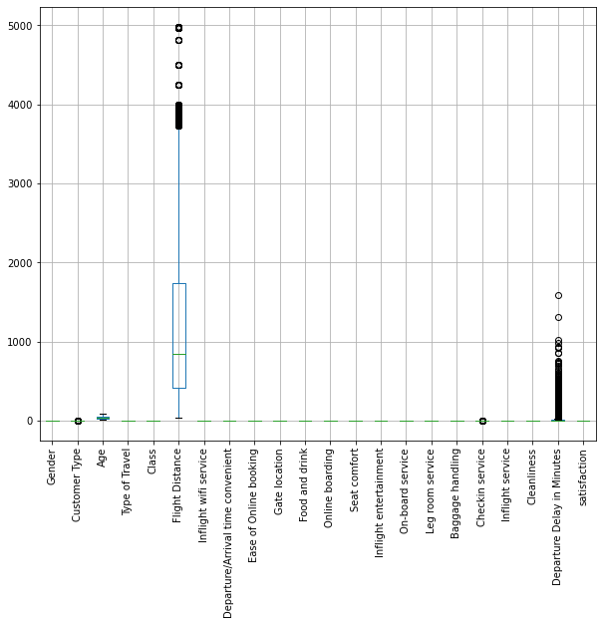
EDA & Preprocessing
As we detect above outliers are in :
Flight Distance
Departure Delay in Minutes
Arrival Delay in Minutes(was dropped)
we decide to convert outliers value by columns median .

Slide 29
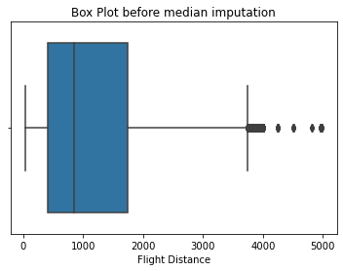
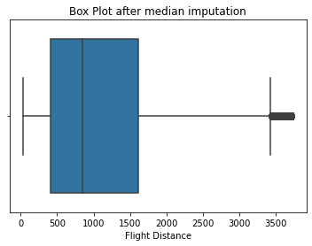
EDA & Preprocessing
flight distance outliers before & after :

Slide 30
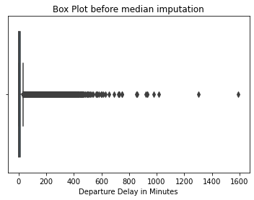
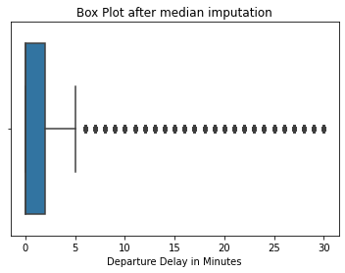
EDA & Preprocessing
delay in minutes outliers before & after :

Slide 31
TRAIN-TEST SPLIT and SCALING:
We have the data already splitted into two data sets “Train” and “Test” data sets .
We create X_train , X_test , Y_train , Y_test data sets from our data by splitting the target from other features .
We used StandardScaler to scale data as there are difference between different columns values.
Scaling helps in speeding up the calculations in an algorithm.

Slide 32
Modeling :
We applied 6 classifier algorithm models:
LogisticRegression
Decision tree
SVM
KNN with pca
RandomForest
XGBoost

Slide 33
Modeling :
MODEL | ACCURACY SCORE
LogisticRegression | 0.8705
Decision tree | 0.9546
SVM | 0.9426
KNN with pca | 0.9113
RandomForest | 0.9634
XGBoost | 0.9643

Slide 34
Modeling :
KNN with PCA :
what is PCA ?
It is a dimensionality-reduction method .
In applying KNN algorithm we find that it takes so many time … so we suggest to use the concept of PCA
To get balance between data information and time elapsed in model we choose to reduce the data into 15 columns.

Slide 35
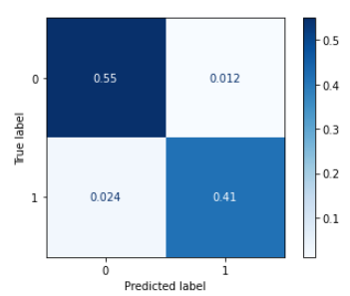
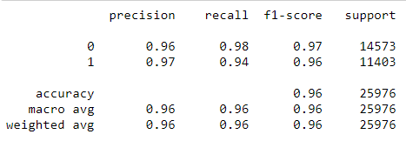
Modeling :
From above :
Best Models are :
XGBoost .. (accuracy = 0.9643)

Slide 36
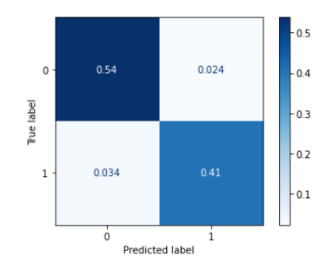
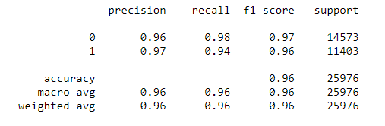
Modeling :
From above :
Best Models are :
RandomForest.. (accuracy = 0.9634)

Slide 37
Modeling :
Finally:
We choosed XGBOOST as the best model because it has lower num in FB (predict satisfied but they aren’t) values .

Slide 38
Code source:
Kaggle: https://www.kaggle.com/omniayasser/airline-passenger-satisfaction
GitHub: https://github.com/Omniayasser/Airline-Passenger-Satisfaction

Slide 39

Thank You!!

